Slide 1
Data Mining
Web Mining
Text Mining
Spatial Data Mining
Temporal Data Mining
Image Processing

Slide 2
Web Mining

Slide 3
Introduction
Definition: Web Mining is the process of extracting useful information, patterns, and knowledge from the vast amount of data available on the World Wide Web.
Types of Web Mining: Web Content Mining, Web Structure Mining, and Web Usage Mining.

Slide 4
Types of Web Mining
1. Web Content Mining
Focuses on extracting information from the actual content of web pages.
Techniques: Text mining, sentiment analysis, information retrieval.
Applications: Information extraction, content categorization, opinion mining.
2. Web Structure Mining
Focuses on analyzing the relationships and connections between web pages.
Techniques: Link analysis, graph theory, social network analysis.
Applications: Page ranking, community detection, recommendation systems.
2. Web Usage Mining
Focuses on understanding user interactions with websites.
Techniques: Log analysis, user profiling, session identification.
Applications: Personalized recommendations, user behavior analysis, website optimization.

Slide 5
Web Content Mining
1. Text Mining
Involves extracting useful information from textual content.
Techniques: Natural Language Processing (NLP), keyword extraction, named entity recognition.
Application: Information retrieval, summarization, content categorization.
2. Sentiment Analysis
Determines the sentiment or emotion expressed in textual content.
Techniques: Machine learning, NLP, sentiment classification.
Application: Understanding user opinions, brand reputation management.

Slide 6
Web Structure Mining
1. Link Analysis
Studies the relationships between web pages through hyperlinks.
Techniques: PageRank, HITS algorithm, link prediction.
Application: Search engine ranking, identifying authoritative pages.
2. Graph Theory
Utilizes graph-based algorithms to analyze web structures.
Techniques: Node centrality, clustering coefficients, shortest path analysis.
Application: Community detection, network visualization.

Slide 7
Web Usage Mining
1. Log Analysis
Examines server logs to understand user interactions.
Techniques: Clickstream analysis, session identification, user navigation patterns.
Application: Improving website design, identifying popular content.
2. User Profiling
Creates profiles of users based on their web interactions.
Techniques: Clustering, pattern recognition, collaborative filtering.
Application: Personalized recommendations, targeted advertising.

Slide 8
Challenges in Web Mining
Data Volume: Dealing with the vast amount of data on the web.
Data Quality: Ensuring accurate and reliable data extraction.
Privacy Concerns: Protecting user privacy while analyzing usage data.
Scalability: Handling the increasing scale of web data.
Dynamic Nature: Adapting to changes in web content and structure.

Slide 9
Applications of Web Mining
E-commerce: Personalized product recommendations.
Search Engines: Improving search results and ranking.
Social Media: Analyzing user behavior and trends.
Healthcare: Extracting medical information from web resources.
Business Intelligence: Market research and competitive analysis.

Slide 10
Ethical and Legal Considerations
Privacy: Respecting user privacy and data protection.
Data Ownership: Addressing issues of content ownership.
Consent: Ensuring user consent for data collection and analysis.
Compliance: Adhering to relevant laws and regulations.

Slide 11
Conclusion
Web Mining is a powerful tool for extracting insights from the web.
It encompasses Content Mining, Structure Mining, and Usage Mining.
As technology evolves, so will the capabilities and applications of Web Mining.
Remember to consider ethical and legal implications while mining the web.

Slide 12
Text Mining

Slide 13
Introduction to Text Mining
Definition: Text mining is the process of extracting valuable information, patterns, and knowledge from unstructured text data.
Importance: In a data-driven world, text mining enables organizations to harness the wealth of information hidden in textual sources.
Applications: Sentiment analysis, topic modeling, document categorization, recommendation systems, and more.

Slide 14
Text Mining Process
Text Collection: Gather unstructured text data from various sources such as websites, social media, documents, and emails.
Preprocessing: Clean and prepare the data by removing noise, punctuation, stopwords, and converting to lowercase.
Tokenization: Break text into individual words or phrases (tokens) for further analysis.
Normalization: Stemming or lemmatization to reduce words to their base forms for consistent analysis.

Slide 15
Text Mining Process
Feature Extraction: Convert text into numerical representations (TF-IDF, word embeddings) suitable for machine learning.
Analysis Techniques: Apply techniques like sentiment analysis, topic modeling, and more depending on the goals.
Modeling: Train models for classification, clustering, or other specific tasks.
Evaluation: Assess model performance, refine parameters, and fine-tune algorithms.
Interpretation: Extract insights, patterns, and knowledge from the analyzed text data.

Slide 16
Text Mining Techniques
Sentiment Analysis: Determine the sentiment or emotional tone of text (positive, negative, neutral) to gauge public opinion.
Topic Modeling: Discover underlying topics within a collection of documents, aiding in understanding content.
Named Entity Recognition (NER): Identify and categorize named entities (people, places, organizations) in text.
Text Classification: Categorize documents into predefined classes or labels based on their content.

Slide 17
Text Mining Techniques
Clustering: Group similar documents together based on their content without predefined categories.
Text Summarization: Create concise summaries of lengthy text, highlighting key information.
Relationship Extraction: Identify connections and relationships between entities mentioned in text.
Pattern Recognition: Detect patterns, trends, or anomalies in text data for insights.

Slide 18
Business Benefits
Customer Insights: Understand customer opinions, preferences, and feedback for improved products and services.
Market Intelligence: Analyze industry trends, competitor strategies, and market sentiment for informed decision-making.
Risk Assessment: Monitor news, reports, and social media to identify potential risks or emerging issues.

Slide 19
Business Benefits
Content Personalization: Tailor content recommendations and user experiences based on text analysis.
Legal and Compliance: Analyze contracts, regulations, and documents for legal and compliance purposes.
Healthcare and Life Sciences: Extract valuable insights from medical literature, patient records, and research papers.

Slide 20
Challenges and Future Trends
Data Quality: Ensuring accurate and representative data for reliable analysis.
Language Complexity: Handling multiple languages, dialects, and idiomatic expressions.
Context Understanding: Capturing context and sarcasm for more accurate analysis.

Slide 21
Challenges and Future Trends
Ethical Considerations: Addressing bias, privacy, and fairness concerns in text mining.
Deep Learning Advances: Continued integration of neural networks for improved language understanding.
Multimodal Analysis: Combining text with other data types like images and audio for richer insights.

Slide 22
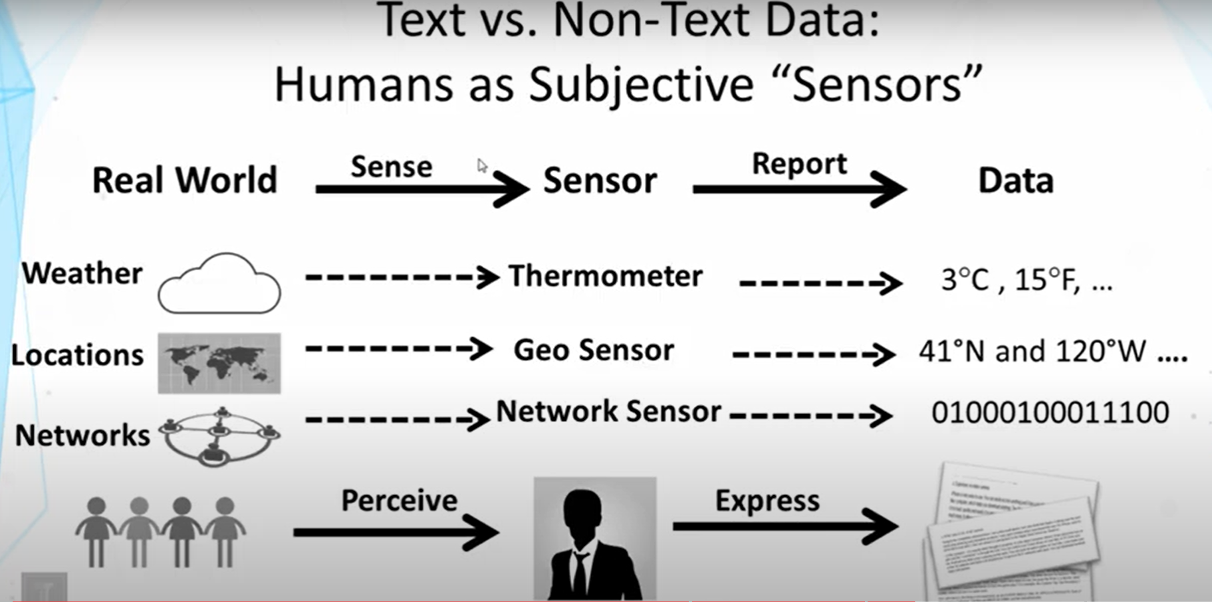

Slide 23
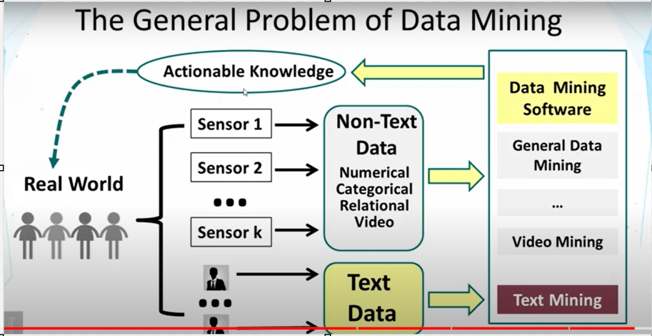

Slide 24
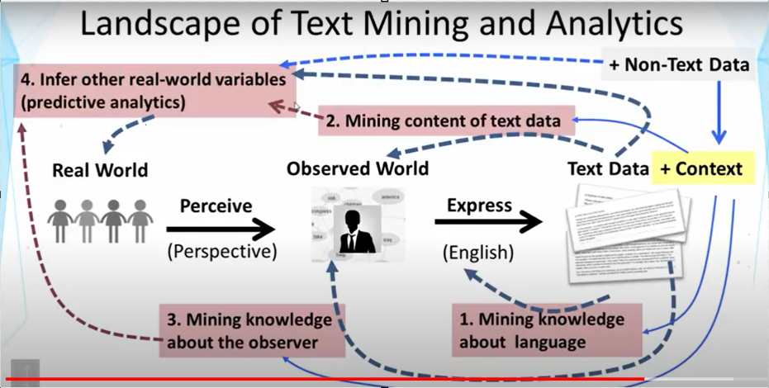

Slide 25
Conclusion
Text mining is a powerful technique to unlock insights from unstructured text data.
Its applications span across industries, enabling data-driven decision-making.
Advancements in AI and NLP will continue to reshape the landscape of text mining.
Embracing text mining empowers organizations to harness the value of their textual assets.

Slide 26
Spatial Data Mining

Slide 27
Introduction to Spatial Data Mining
Definition: Spatial Data Mining is the process of discovering hidden patterns, relationships, and knowledge from data that has a geographic or spatial component.
Significance: In an increasingly location-aware world, spatial data mining empowers decision-makers with valuable insights related to geography.
Applications: Urban planning, environmental monitoring, logistics optimization, epidemiology, and more.

Slide 28
Spatial Data Characteristics
Location: Data points have associated geographic coordinates (latitude, longitude).
Topology: Relationship between nearby and distant features in a spatial context.
Geometry: Shapes and sizes of geographic features, e.g., points, lines, polygons.
Attributes: Additional non-spatial data associated with geographic features.
Scale: Varying levels of spatial granularity, from global to local.

Slide 29
Spatial Data Mining Process Overview
Data Collection: Acquire spatial data from sources like GPS, satellite imagery, remote sensors, and geographic databases.
Preprocessing: Clean, integrate, and transform data to ensure consistency and quality.
Spatial Indexing: Organize data for efficient spatial queries and analysis.
Spatial Pattern Detection: Identify spatial relationships, clusters, and trends.

Slide 30
Spatial Data Mining Process Overview
Spatial Prediction: Make predictions about unobserved locations based on observed patterns.
Spatial Classification: Categorize spatial units into predefined classes based on attributes and location.
Spatial Association: Discover co-occurring features and patterns within spatial data.
Visualization: Present results using maps, heatmaps, and other spatial representations.

Slide 31
Spatial Data Mining Techniques
Spatial Clustering: Identify clusters of geographically close data points that share similar attributes.
Spatial Outlier Detection: Identify data points that deviate significantly from the expected spatial pattern.
Spatial Regression: Explore relationships between spatially distributed variables and non-spatial attributes.

Slide 32
Spatial Data Mining Techniques
Spatial Interpolation: Estimate values at unobserved locations based on nearby observations.
Geospatial Association Rule Mining: Discover associations between spatial features and their attributes.
Spatial Autocorrelation Analysis: Assess the degree of similarity between neighboring locations.
Spatial Decision Trees: Hierarchical models for classifying spatial data based on attributes and location.

Slide 33
Business Applications
Retail and Marketing: Optimize store locations, analyze foot traffic, and target customers based on geographic patterns.
Logistics and Supply Chain: Optimize routes, track shipments, and manage inventory with location intelligence.
Environmental Monitoring: Analyze patterns of pollution, deforestation, and natural resource distribution.

Slide 34
Business Applications
Urban Planning: Plan infrastructure, transportation, and services by analyzing population distribution and trends.
Epidemiology: Track disease outbreaks, analyze disease spread, and allocate healthcare resources.
Natural Disaster Management: Predict and respond to natural disasters using spatial data insights.

Slide 35
Challenges and Future Trends
Data Quality: Ensuring accuracy and precision in geographic data.
Spatial Heterogeneity: Handling variations in data distribution and density.
Scale Issues: Addressing challenges related to analyzing data at different spatial scales.
Privacy Concerns: Protecting sensitive location-based information.
Integration with AI: Combining spatial data mining with machine learning and AI techniques for more robust insights.

Slide 36
Conclusion
Spatial Data Mining unlocks insights from geographic data, facilitating informed decision-making.
It plays a crucial role in understanding the spatial aspects of various domains.
Continued advancements in technology will further enhance the capabilities of spatial data mining.
Integrating spatial intelligence empowers organizations to leverage the geographical component of their data.

Slide 37
Temporal Mining

Slide 38
Introduction to Temporal Mining
Temporal mining is the process of extracting valuable patterns, trends, and insights from time-based data.
It involves analyzing data sequences and timestamps to reveal temporal relationships and dependencies.

Slide 39
Applications of Temporal Mining
Financial Forecasting
Predict stock prices, market trends, and economic indicators based on historical data patterns.
Identify optimal trading times and investment opportunities.
Healthcare Analysis
Monitor patient vitals and medical records over time to predict disease progression.
Analyze treatment effectiveness and patient response patterns.

Slide 40
Applications of Temporal Mining
Customer Behavior Analysis
Study customer interactions, purchase histories, and preferences to forecast buying patterns.
Optimize marketing strategies and tailor personalized recommendations.
Manufacturing and Supply Chain
Analyze production schedules, lead times, and inventory levels to optimize supply chain operations.
Predict equipment maintenance needs and minimize downtime.

Slide 41
Temporal Mining Techniques
Time Series Analysis
Analyze sequential data points to uncover patterns and trends.
Methods: Moving averages, exponential smoothing, ARIMA, etc.
Sequential Pattern Mining
Discover frequent patterns in sequences of events or actions.
Applications: Market basket analysis, clickstream analysis.

Slide 42
Temporal Mining Techniques
Temporal Association Rule Mining
Identify associations between events that occur within specific time windows.
Useful for cross-selling, event correlation, and anomaly detection.
Temporal Clustering
Group similar temporal data points based on patterns and characteristics.
Clusters can help uncover insights about different temporal behaviors.

Slide 43
Challenges and Considerations
Data Preprocessing
Cleaning and aligning timestamps for accurate analysis.
Handling missing data and outliers.
Temporal Granularity
Choosing the appropriate time intervals or scales for analysis.
Balancing between fine-grained and coarse-grained views.
Handling Dynamic Patterns
Adapting to changing temporal behaviors and trends.

Slide 44
Benefits of Temporal Mining
Enhanced decision-making through deeper understanding of time-related patterns.
Improved predictive capabilities for various industries.
Enables proactive strategies based on forecasted trends and events.

Slide 45
Conclusion
Temporal mining empowers organizations to extract meaningful insights from time-based data.
By analyzing temporal relationships, businesses can make informed decisions and gain a competitive edge.

Slide 46
Image Processing

Slide 47
Image Processing Definition
Image processing is a field of computer science that focuses on manipulating and analyzing digital images.
It involves various techniques to enhance, transform, and extract information from images.

Slide 48
Importance of Image Processing
Medical Imaging: Used in diagnosing and monitoring medical conditions through techniques like X-ray, MRI, and CT scans.
Security: Enhances surveillance systems by detecting anomalies and recognizing faces or objects.
Entertainment: Enables special effects, CGI, and image enhancements in movies and video games.

Slide 49
Importance of Image Processing
Remote Sensing: Analyzes satellite images for environmental monitoring, disaster assessment, and urban planning.
Industrial Automation: Quality control in manufacturing, robot vision, and defect detection in products.
Biometrics: Fingerprints, retinal scans, and facial recognition for identification and security purposes.

Slide 50

Types of Image Processing
Image Enhancement
Improving visual quality by adjusting contrast, brightness, sharpness, and color balance.

Slide 51

Image Restoration
Removing noise, distortions, and artifacts caused by various factors.

Slide 52

Image Compression
Reducing image size for efficient storage and transmission.

Slide 53
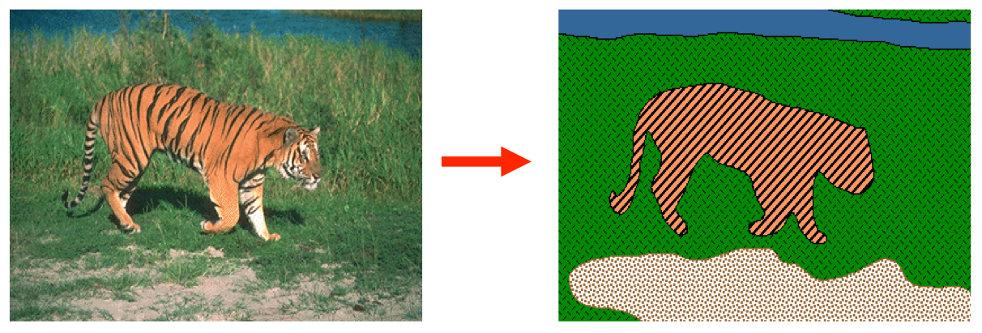
Image Segmentation
Dividing an image into meaningful regions for further analysis.

Slide 54
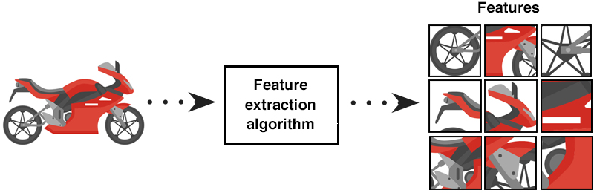
Feature Extraction
Identifying and extracting important characteristics from an image.

Slide 55
Image Processing Workflow
Image Acquisition: Capturing an image using cameras, scanners, or other devices.
Preprocessing: Removing noise, correcting distortions, and enhancing image quality.
Image Enhancement: Improving the visual appearance of the image.

Slide 56
Image Processing Workflow
Image Analysis: Extracting useful information from the image, such as object detection or recognition.
Image Interpretation: Drawing conclusions based on the analysis results.
Post-processing: Final adjustments, formatting, and presentation of the processed image.

Slide 57
Image Processing Techniques
Filters: Applying convolutional filters for blurring, sharpening, edge detection, etc.
Transforms: Utilizing Fourier, Wavelet, or Hough transforms for frequency and shape analysis.
Machine Learning: Employing algorithms like neural networks for object detection and image generation.

Slide 58
Image Processing Techniques
Morphological Operations: Manipulating shapes within an image using dilation, erosion, opening, and closing.
Segmentation Algorithms: Clustering, region-growing, and thresholding for partitioning an image.
Feature Detection: Identifying keypoints, edges, and textures for object recognition.

Slide 59
Future Trends
Deep Learning: Advancements in neural networks for more accurate and complex image processing tasks.
Real-time Processing: Faster algorithms and hardware for immediate results in various applications.
3D Image Processing: Extending techniques to handle volumetric data from medical scans and 3D sensors.
Mixed Reality: Integrating image processing with augmented and virtual reality experiences.

Slide 60
Conclusion
Image processing plays a crucial role in various domains, enhancing visual quality, enabling advanced analysis, and providing valuable insights from digital images. As technology evolves, the field continues to expand, leading to exciting possibilities and challenges.

